Slide 1

Department of Computer Science
University Institute of Engineering
DEPARTMENT OF COMPUTER SCIENCE & ENGINEERING
Bachelor of Engineering
Subject Name: System Programming
Subject Code: CST-315
Compilers
DISCOVER . LEARN . EMPOWER

Slide 2
2.4 Assembler Design Options
Load-and-Go Assembler
One-pass assemblers
Multi-pass assemblers
Advanced Assembly Process
129
PDF created with FinePrint pdfFactory Pro trial version www.pdffactory.com

Slide 3
Load-and-Go Assembler
No object program is written out, no loader is needed
Useful for program development and testing
Avoids the overhead of writing the object program out and reading it back in
Both one-pass and two-pass assemblers can be designed as load-and-go
However, one-pass also avoids the overhead of an additional pass over the source program
For a load-and-go assembler, the actual address must be known at assembly time.
132
PDF created with FinePrint pdfFactory Pro trial version www.pdffactory.com

Slide 4
Two Types of One-Pass Assemblers:
Load-and-go assembler
Produces object code directly in memory for immediate execution
The other assembler
Produces usual kind of object code for later execution
131
PDF created with FinePrint pdfFactory Pro trial version www.pdffactory.com

Slide 5
Forward Reference
All symbol-defining directives do not allow forward reference for 2-pass assembler
e.g., EQU, ORG…
All symbols used on the right-hand side of the statement must have been defined previously
E.g. (Cannot be assembled in 2-pass assm.)
ALPHA | EQU | BETA
BETA | EQU | DELTA
DELTA | RESW | 1
 |  | 88
PDF created with FinePrint pdfFactory Pro trial version www.pdffactory.com

Slide 6
2.4.1 One-Pass Assemblers
Goal: avoid a second pass over the source program
Main problem
Forward references to data items or labels on instructions
Solution
Data items: require all such areas be defined before they are referenced
Label on instructions: cannot be eliminated
E.g. the logic of the program often requires a forward jump
It is too inconvenient if forward jumps are not permitted
130
PDF created with FinePrint pdfFactory Pro trial version www.pdffactory.com

Slide 7
Forward Reference Handling in One-pass Assembler
When the assembler encounter an instruction operand that has not yet been defined:
The assembler omits the translation of operand address
Insert the symbol into SYMTAB, if not yet exist, and mark this symbol undefined
The address that refers to the undefined symbol is added to a list of forward references associated with the symbol table entry
When the definition for a symbol is encountered
The forward reference list for that symbol is scanned
The proper address for the symbol is inserted into any instructions previous generated.
133
PDF created with FinePrint pdfFactory Pro trial version www.pdffactory.com

Slide 8
Handling Forward Reference in One-pass Assembler (Cont.)
At the end of the program
Any SYMTAB entries that are still marked with * indicate undefined symbols
□ Be flagged by the assembler as errors
Search SYMTAB for the symbol named in the END statement and jump to this location to begin execution of the assembled program.
134
PDF created with FinePrint pdfFactory Pro trial version www.pdffactory.com

Slide 9
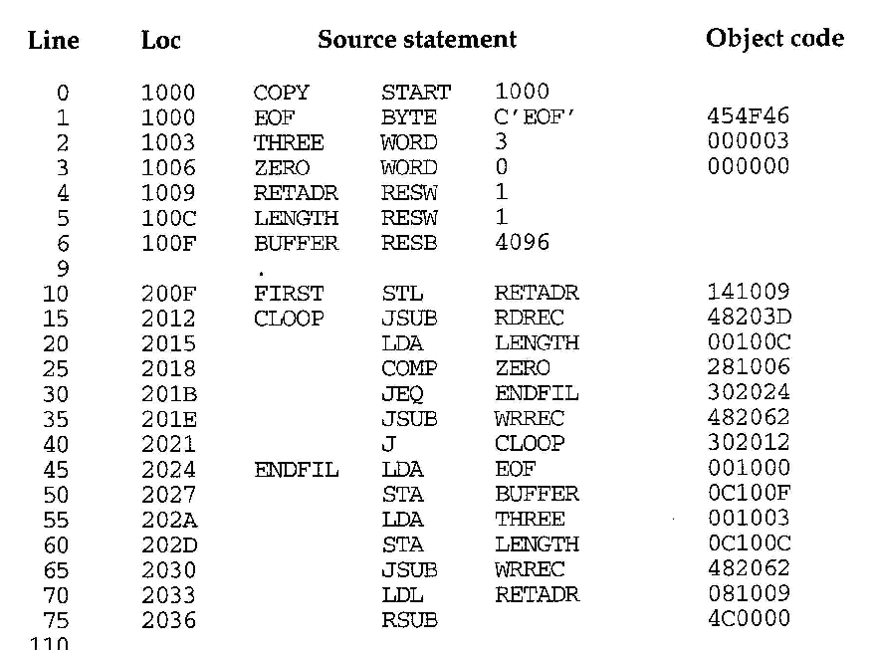
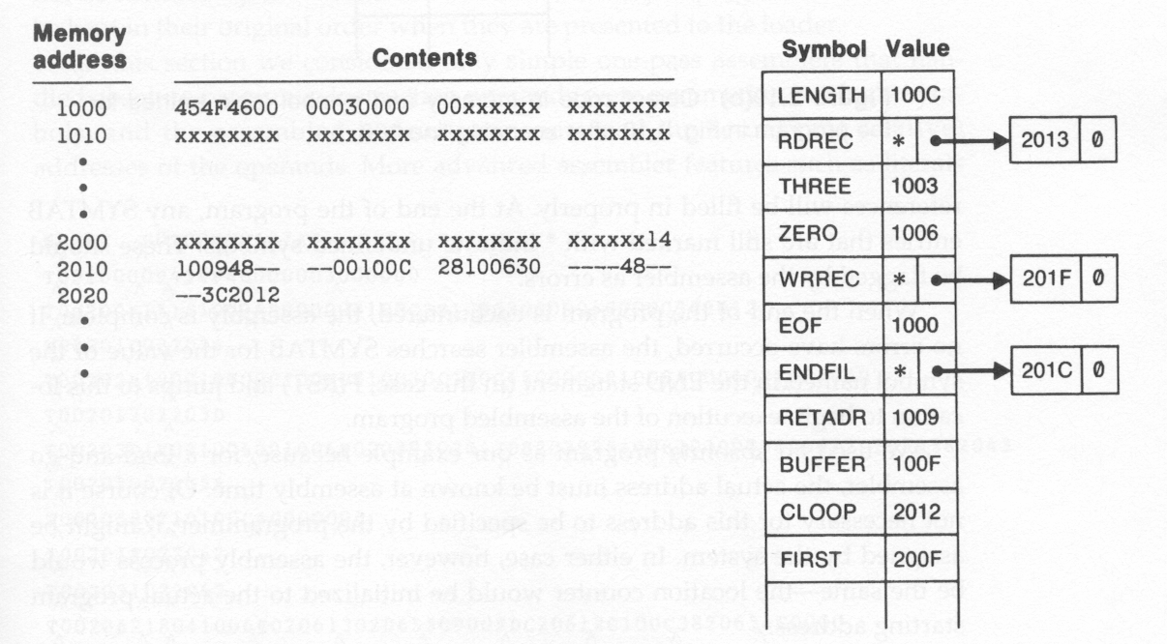
Sample Program for a One-Pass Assembler (Fig. 2.18)
135
PDF created with FinePrint pdfFactory Pro trial version www.pdffactory.com

Slide 10
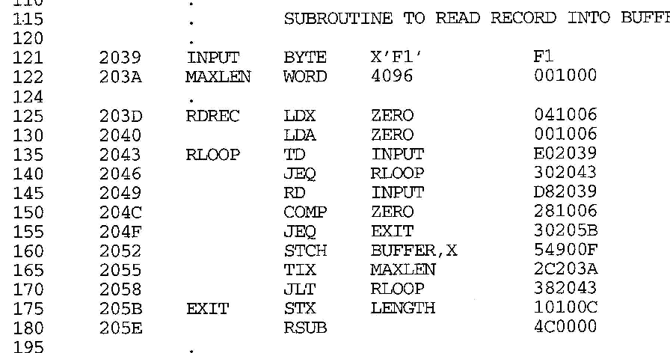
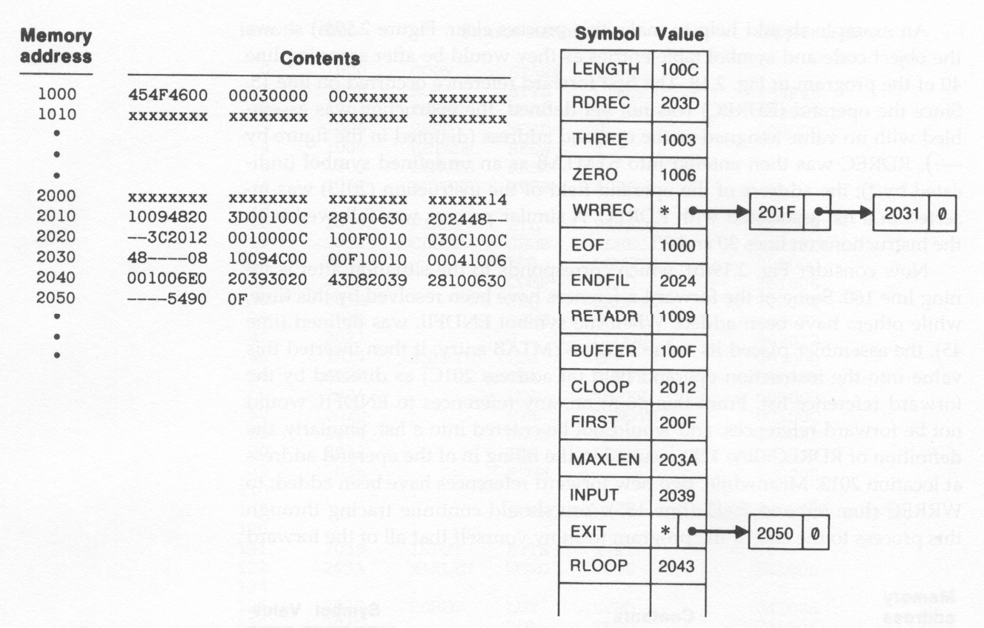
Sample Program for a One-Pass Assembler (Fig. 2.18) (Cont.)
136
PDF created with FinePrint pdfFactory Pro trial version www.pdffactory.com
141

Slide 11
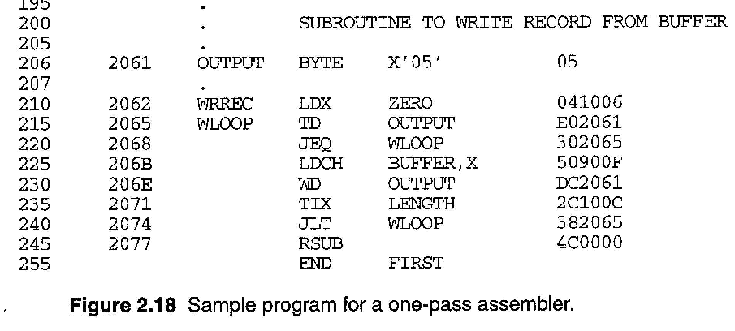
Sample Program for a One-Pass Assembler (Fig. 2.18) (Cont.)
137
PDF created with FinePrint pdfFactory Pro trial version www.pdffactory.com

Slide 12
Example
□ Fig. 2.19 (a)
Show the object code in memory and symbol table entries after scanning line 40
Line 15: forward reference (RDREC)
Object code is marked ----
Value in symbol table is marked as * (undefined)
Insert the address of operand (2013) in a list associated with RDREC
Line 30 and Line 35: follow the same procedure
138
PDF created with FinePrint pdfFactory Pro trial version www.pdffactory.com

Slide 13
Object Code in Memory and SYMTAB
After scanning line 40
139
PDF created with FinePrint pdfFactory Pro trial version www.pdffactory.com

Slide 14
Example (Cont.)
□ Fig. 2.19 (b)
Show the object code in memory and symbol table entries after scanning line 160
Line 45: ENDFIL was defined
Assembler place its value in the SYMTAB entry
Insert this value into the address (at 201C) as directed by the forward reference list
Line 125: RDREC was defined
Follow the same procedure
Line 65
new forward reference (WRREC)
140
PDF created with FinePrint pdfFactory Pro trial version www.pdffactory.com

Slide 15
Object Code in Memory and SYMTAB
After scanning line 160
141
PDF created with FinePrint pdfFactory Pro trial version www.pdffactory.com

Slide 16
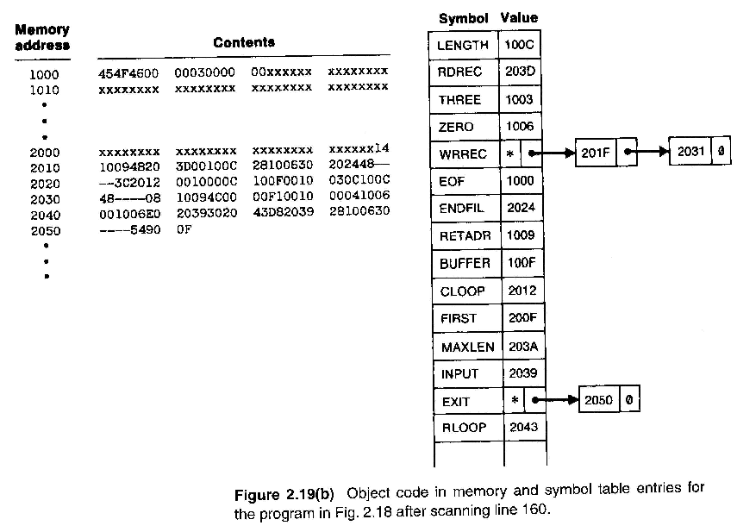
Object Code in Memory and SYMTAB Entries for Fig 2.18 (Fig. 2.19b)
142
PDF created with FinePrint pdfFactory Pro trial version www.pdffactory.com

Slide 17
One-Pass Assembler Producing Object Code
Forward reference are entered into the symbol table’s list as before
If the operand contains an undefined symbol, use 0 as the address and write the Text record to the object program.
However, when definition of a symbol is encountered, the assembler must generate another Text record with the correct operand address.
When the program is loaded, this address will be inserted into the instruction by loader.
The object program records must be kept in their original order when they are presented to the loader
143
PDF created with FinePrint pdfFactory Pro trial version www.pdffactory.com

Slide 18
Example
In Fig. 2.20
Second Text record contains the object code generated from lines 10 through 40
The operand addressed for the instruction on line 15, 30, 35 have been generated as 0000
When the definition of ENDFIL is encountered
Generate the third Text record
Specify the value 2024 ( the address of ENDFIL) is to be loaded at location 201C ( the operand field of JEQ in line 30)
Thus, the value 2024 will replace the 0000 previously loaded
144
PDF created with FinePrint pdfFactory Pro trial version www.pdffactory.com

Slide 19
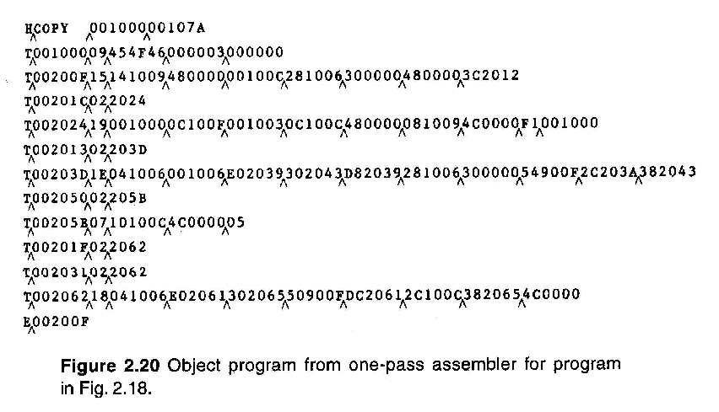

Object Program from one-pass assembler for Fig 2.18 (Fig 2.20)
201C
1
45
PDF created with FinePrint pdfFactory Pro trial version www.pdffactory.com

Slide 20
2.4.2 Multi-Pass Assemblers
Motivation: for a 2-pass assembler, any symbol used on the right-hand side should be defined previously.
No forward references since symbols’ value can’t be defined during the first pass
□ E.g.
APLHA BETA DELTA
EQU BETA EQU DELTA
Not allowed !
RESW 1
146
PDF created with FinePrint pdfFactory Pro trial version www.pdffactory.com

Slide 21
Multi-Pass Assemblers (Cont.)
Multi-pass assemblers
Eliminate the restriction on EQU and ORG
Make as many passes as are needed to process the definitions of symbols.
Implementation
To facilitate symbol evaluation, in SYMTAB, each entry must indicates which symbols are dependent on the values of it
Each entry keeps a linking list to keep track of whose symbols’ value depend on an this entry
147
PDF created with FinePrint pdfFactory Pro trial version www.pdffactory.com

Slide 22
Example of Multi-pass Assembler Operation (fig 2.21a)
HALFSZ MAXLEN PREVBT | EQU EQU EQU | MAXLEN/2 BUFEND - BUFFER BUFFER - 1
.
.
.
BUFFER | RESB | 4096
BUFEND | EQU | *
148
PDF created with FinePrint pdfFactory Pro trial version www.pdffactory.com

Slide 23
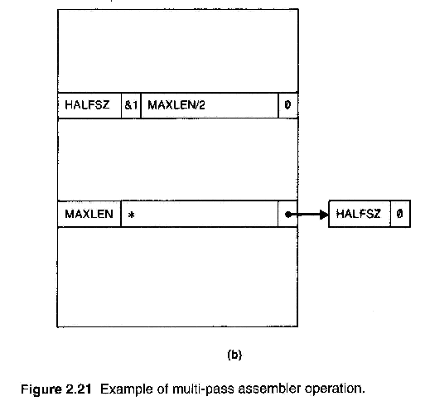
Example of Multi-Pass Assembler Operation (Fig 2.21b)
HALFSZ MAXLEN PREVBT | EQU EQU EQU | MAXLEN/2 BUFEND-BUFFER BUFFER-1
. . . BUFFER | RESB | 4096
BUFEND | EQU | *
*: undefined
A list of the symbols whose values depend on MAXLEN
149
PDF created with FinePrint pdfFactory Pro trial version www.pdffactory.com

Slide 24
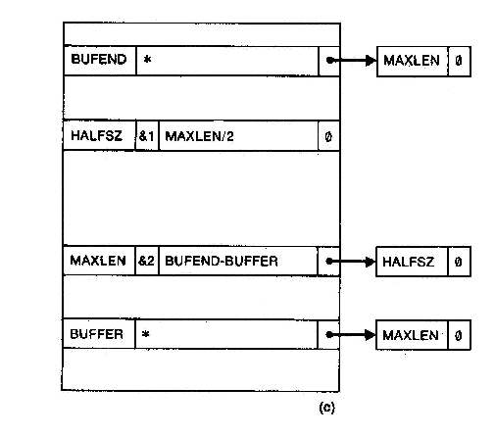
Example of Multi-Pass Assembler Operation (Fig 2.21c)
HALFSZ MAXLEN PREVBT . | EQU EQU EQU | MAXLEN/2 BUFEND-BUFFER BUFFER-1
.
.
BUFFER | RESB | 4096
BUFEND | EQU | *
150
PDF created with FinePrint pdfFactory Pro trial version www.pdffactory.com

Slide 25
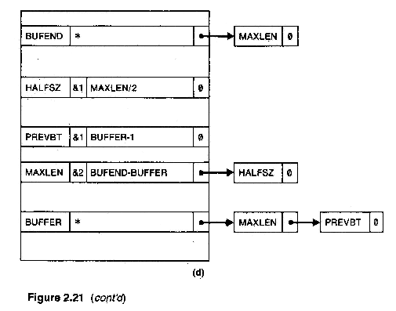
Example of Multi-pass Assembler Operation (fig 2.21d)
HALFSZ MAXLEN PREVBT | EQU EQU EQU | MAXLEN/2 BUFEND-BUFFER BUFFER-1
. . . BUFFER | RESB | 4096
BUFEND | EQU | *
151
PDF created with FinePrint pdfFactory Pro trial version www.pdffactory.com

Slide 26
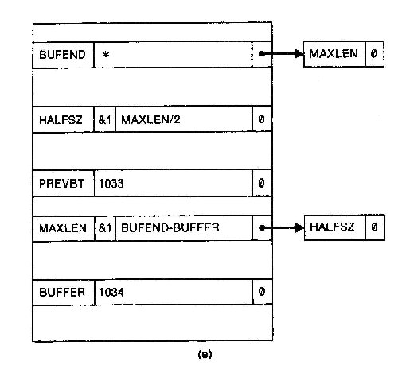
Example of Multi-pass Assembler
Operation (fig 2.21e)
HALFSZ MAXLEN PREVBT | EQU EQU EQU | MAXLEN/2 BUFEND-BUFFER BUFFER-1
. . . BUFFER | RESB | 4096
BUFEND | EQU | *
Suppose Buffer =* = (PC)=1034₁₆
152
PDF created with FinePrint pdfFactory Pro trial version www.pdffactory.com

Slide 27
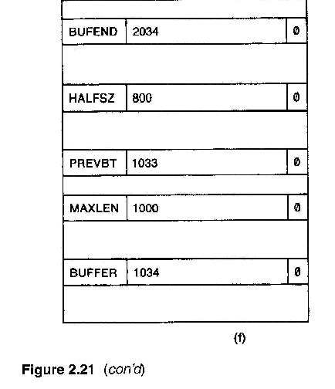

Example of Multi-pass Assembler Operation (Fig 2.21f)
BUFEND=*(PC)=1034₁₆+4096₁₀=1034₁₆+1000₁₆=2034₁₆
HALFSZ MAXLEN PREVBT | EQU EQU EQU | MAXLEN/2 BUFEND-BUFFER BUFFER-1
. . . BUFFER | RESB | 4096
BUFEND | EQU | *
1
53
PDF created with FinePrint pdfFactory Pro trial version www.pdffactory.com

Slide 28
2.5 Implementation Examples
Microsoft MASM Assembler
Sun Sparc Assembler
IBM AIX Assembler
154
PDF created with FinePrint pdfFactory Pro trial version www.pdffactory.com

Slide 29
2.5.1 Microsoft MASM Assembler
Microsoft MASM assembler for Pentium and other x86 systems.
Programmer of an x86 system views memory as a collection of segments
Each segment is defined as belonging to a particular class, CODE, DATA, CONST, STACK
Registers: CS (code), SS (stack), DS (data), ES, FS, GS
155
PDF created with FinePrint pdfFactory Pro trial version www.pdffactory.com

Slide 30
Multi-Pass Assemblers
Microsoft MASM Assembler (Contd.)
JUMP with forward reference
near jump: 2 or 3 bytes
far jump: 5 bytes

Slide 31
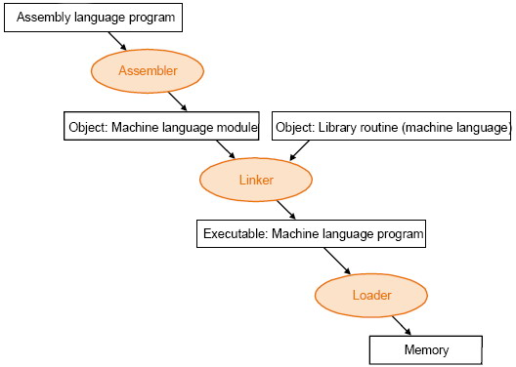
Advanced Assembly process

Slide 32
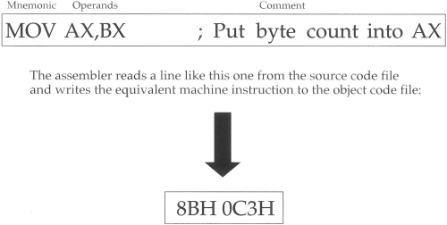
Advanced Assembly Process (Example)

Slide 33
Advanced Assembly Process
Assembling
At assembly time, the assembler:
Evaluates conditional-assembly directives, assembling if the conditions are true.
Expands macros and macro functions.
Evaluates constant expressions such as MYFLAG AND 80H, substituting the calculated value for the expression.
Encodes instructions and non address operands. For example, mov cx, 13; can be
encoded at assembly time because the instruction does not access memory.
Saves memory offsets as offsets from their segments.
Places segments and segment attributes in the object file.
Saves placeholders for offsets and segments (relocatable addresses).
Outputs a listing if requested.
Passes messages (such as INCLUDELIB) directly to the linker.

Slide 34
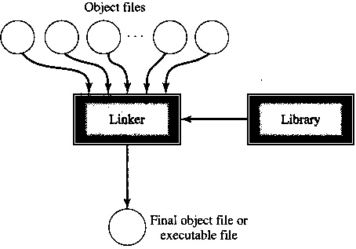
Advanced Assembly Process
Linking
Once your source code is assembled, the resulting object file is passed to the linker. At this point, the linker may combine several object files into an executable program. The linker: Combines segments according to the instructions in the object files, rearranging the positions of segments that share the same class or group. Fills in placeholders for offsets (relocatable addresses). Writes relocations for segments into the header of .EXE files (but not .COM files). Writes the result as an executable program file.

Slide 35
Advanced Assembly Process
Loading
After loading the executable file into memory, the operating system:
Creates the program segment prefix (PSP) header in memory.
Allocates memory for the program, based on the values in the PSP.
Loads the program.
Calculates the correct values for absolute addresses from the relocation table.
Loads the segment registers SS, CS, DS, and ES with values that point to the proper areas of memory.

Slide 36
Advanced Assembly Process
Useful Tools and Utilities
DUMPBIN disassembly program
Debuggers: OllyDbg and WinDbg
Consol I/O: iolib.

Slide 37
References
Department of computer Science
[PDF] Systems Programming and Operating Systems by Dhamdhere - Free Download PDF (dlscrib.com)
[PDF] Principles of Compiler Design By Alfred V. Aho & J.D.Ullman Free Download – Learnengineering.in

Slide 38
THANK YOU

